Slide 1
CS595—Big Data Technologies
Module 11
NoSQL

Slide 2
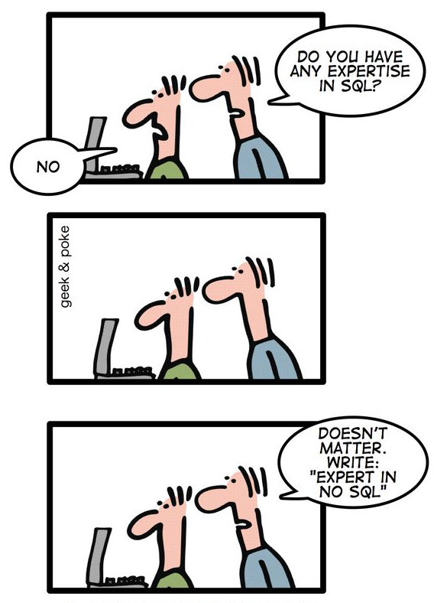
Leveraging the NoSQL Boom

Slide 3
Database Alternatives
OldSQL
Legacy relational databases
NoSQL
Give up SQL and ACID for performance
NewSQL
Preserve SQL and ACID
Get performance from a new architecture

Slide 4
The Relational Model
E.F. Codd: (1923-2003)
Developed the relational model while at IBM San Jose Research Laboratory
IBM Fellow 1976
Turing Award 1981
ACM Fellow 1994
British, by birth
Notes:
"Microarrays allow us to see if a particular gene is on or off in a particular tissue. The colors on this picture correspond to whether or not the gene is expressed. So each row is a gene, and each column is a particular experiment, for example a particular type of tissue. If you see a red spot for some gene for breast tumors, that means this gene is expressed in breast cancer. But that same gene is not expressed in the brain, for example."

Slide 5
The Relational Model
“A Relational Model of Data for Large Shared Data Banks,” E.F. Codd, Communications of the ACM, Vol. 13, No. 6, June, 1970.
“Further Normalization of the Data Base Relational Model,” E.F. Codd, Data Base Systems, Proceedings of 6th Courant Computer Science Symposium, May, 1971.
“Relational Completeness of Data Base Sublanguages,” E.F. Codd, Data Base Systems, Proceedings of 6th Courant Computer Science Symposium, May, 1971.
Plus others…
Notes:
Codd actually doesn’t say “relational algebra,” but rather focuses on tuple calculus when he talks about DB operations.
Does not discuss normal forms beyond 1NF.

Slide 6
The Relational Model
The basic data model:
Relations, tuples, attributes, domains
Primary & foreign keys
Normal forms
Query model:
Relational algebra – Cartesian product, selection, projection, union, set-difference
Relational calculus
A primary theme:
Physical data independence
“Employee”
ID Last-Name Date-of-Birth Job-Type
15394 Jones 11/3/75 Software
21621 Smith 6/24/69 Management
17852 Brown 8/14/72 Hardware
32904 Carson 10/29/64 Software
:
:
Notes:
Codd actually doesn’t say “relational algebra,” but rather focuses on tuple calculus when he talks about DB operations.
Does not discuss normal forms beyond 1NF.

Slide 7
Relational Database Management Systems (RDBMS)
Database Management Systems Based on the Relational Model:
System R – IBM research project (1974)
Ingres – University of California Berkeley (early 1970’s)
Oracle – Rational Software, now Oracle Corporation (1974)
SQL/DS – IBM’s first commercial RDBMS (1981)
Informix – Relational Database Systems, now IBM (1981)
DB2 – IBM (1984)
Sybase SQL Server – Sybase, now SAP (1988)
Notes:
"Microarrays allow us to see if a particular gene is on or off in a particular tissue. The colors on this picture correspond to whether or not the gene is expressed. So each row is a gene, and each column is a particular experiment, for example a particular type of tissue. If you see a red spot for some gene for breast tumors, that means this gene is expressed in breast cancer. But that same gene is not expressed in the brain, for example."

Slide 8
Structure Query Language (SQL)
SQL is a language for querying relational databases.
History:
Developed at IBM San Jose Research Laboratory, early 1970’s, for System R
Credited to Donald D. Chamberlin and Raymond F. Boyce
Based on relational algebra and tuple calculus
Originally called SEQUEL
Notes:
"Microarrays allow us to see if a particular gene is on or off in a particular tissue. The colors on this picture correspond to whether or not the gene is expressed. So each row is a gene, and each column is a particular experiment, for example a particular type of tissue. If you see a red spot for some gene for breast tumors, that means this gene is expressed in breast cancer. But that same gene is not expressed in the brain, for example."

Slide 9
SQL Databases
"SQL" is used both as the name of a language and a type of database
SQL, the language - Structured Query Language - is designed for managing data in relational database management systems (RDBMS)
Relational database management systems are often called SQL databases as they use the SQL language
Since the mid-1980s, SQL has been a standard for querying and managing RDBMS data sets

Slide 10
SQL Databases
Relational databases continue to provide the foundation for the world's transactions
Think about all the credit card transactions being handled by the mainframes and large UNIX servers in the data centers of financial services companies
But web-scale proved to be a great challenge to those traditional RDBMSs…
You couldn't build a single shared resource machine big enough to handle the demands

Slide 11
Relational Query Languages
Other Relational Query Languages:
Datalog
QUEL
Query By Example (QBE)
SQL variations
shell scripts, with relational extensions
Notes:
"Microarrays allow us to see if a particular gene is on or off in a particular tissue. The colors on this picture correspond to whether or not the gene is expressed. So each row is a gene, and each column is a particular experiment, for example a particular type of tissue. If you see a red spot for some gene for breast tumors, that means this gene is expressed in breast cancer. But that same gene is not expressed in the brain, for example."

Slide 12
Transactions – ACID Properties
Atomic – All of the work in a transaction completes (commit) or none of it completes
Consistent – A transaction transforms the database from one consistent state to another consistent state. Consistency is defined in terms of constraints.
Isolated – The results of any changes made during a transaction are not visible until the transaction has committed.
Durable – The results of a committed transaction survive failures

Slide 13
SQL Features
Rely on relational tables
Utilize defined data schema
Reduce redundancy through normalization
Support JOIN functionality
Engineered for data integrity
Traditionally scale up, not out
Rely on a simple, standardized query language
Near universal in adoption

Slide 14
SQL Database Advantages
ACID transactions at the database level makes certain business app development easier
Fine-grained security on columns and rows using views prevents views and changes by unauthorized users
Most SQL code is portable to other SQL databases, including open source options
Typed columns and constraints will validate data before it’s added to the database and increase data quality
Existing staff members are already familiar with entity-relational design and SQL

Slide 15
SQL Database Drawbacks
The object-relational mapping layer can be complex
Entity-relationship modeling must be completed before testing begins, which slows development
RDBMSs don’t scale out when joins are required
Sharding over many servers can be done but is costly and will be operationally inefficient
Full-text search requires third-party tools
It can be difficult to store high-variability data in tables

Slide 16
NoSQL Databases
While NoSQL technologies have existed for decades, they didn't gain popularity until the early 2000s
Organizations sought solutions to house massive quantities of big data at rest more cheaply than they could with RDBMSs
And then to be able to handle the higher and higher velocity of incoming data.
While an SQL (relational) database is a defined, concrete concept, a NoSQL database is not

Slide 17
NoSQL Databases
There is enormous variation in technologies that fall under the NoSQL category
So, NoSQL is a term used for a broad group of data management technologies that vary in features and functionality…
But which address some critical big data challenges of SQL databases

Slide 18
NoSQL Databases
A NoSQL database…
Provides a mechanism for storage and retrieval of data
That is modeled in means other than the tabular relations used in relational databases
A NoSQL database…
Is a non-relational…
And largely distributed database system…
That enables rapid, ad-hoc organization…
And analysis of extremely high-volume, disparate data types

Slide 19
BASE Concept
BASE is a vague term often used as contrast to ACID
Basically Available
Availability first
The system works basically all the time
Partial failures can occur, but without total system failure
Soft state
The system is in flux (unstable), non-deterministic state
Changes occur all the time
Eventual consistency
The system will be in some consistent state
At some time in future

Slide 20
NoSQL Features
High performance writes and massive scalability
Does not require a defined schema for writing data
Primarily eventually-consistent by default
Support wide range of modern programming languages and tools

Slide 21
Why NoSQL?
NoSQL began as a movement to replace relational databases for specific needs…
Particularly for gathering and storing massive amounts of data…
Like all the web activity data of users of sites like Google, Twitter, LinkedIn, and Facebook
There were no transactions going on -- just collecting and consolidating massive amounts of data on page links
Also recall that Hadoop came out of Google's need to compute page rankings

Slide 22
Why NoSQL?
Google could easily throw out most of the historical relational database model…
Since little of it was needed for their use case
They wanted to store terabytes and then petabytes of data, cheaply and easily…
And then be able to run batch analytics on all that data
Other large web-based companies also discovered that traditional transactional systems had too much baggage…
And offered too few benefits for their particular and distinct use cases

Slide 23
Why NoSQL?
Google’s efforts were made public and documented in a technical paper in 2006…
Bigtable: A Distributed Storage System for Structured Data, Fay Chang, Jeffrey Dean, Sanjay Ghemawat, Wilson C. Hsieh, Deborah A. Wallach, Mike Burrows, Tushar Chandra, Andrew Fikes, Robert E. Gruber, 7th USENIX Symposium on Operating Systems Design and Implementation (OSDI), 2006, pp. 205-218.

Slide 24
Why NoSQL?
It is important to understand that the authors of this paper focus on solving a set of pragmatic business problems…
And not exploring the range of theoretical considerations around creating a distributed databases
Instead they leverage a Google system called “Chubby” for distributed application management
Chubby functions much the same as Apache Zookeeper which we encountered in our discussions of Hadoop
But otherwise issues of data consistency and availability are considered in an engineering context
So, NoSQL databases, while they can be understood via distributed system theories, are first business software

Slide 25
Why NoSQL?
NoSQL solutions are primarily about getting rid of structure
Part of the power of relational database systems is the "relational" piece
There are strict and governed relations within the database that are embodied in the schema
You aren't allowed to write arbitrary data into a relational database…
It has to fit properly into the schema -- and the database software will deny the attempted write if it doesn't

Slide 26
Why NoSQL?
The primary need of the NoSQL designers was to…
Collect all the data that was being generated by and about their users, regardless of the type of data
They didn't want to be encumbered by schema, at least not when the data was being written ("schema on write")

Slide 27
Why NoSQL?
In order to analyze the data, you do need to know what and where the data you are trying to analyze is
NoSQL solutions in effect defer the schema question -- they are happy to try to figure out the schema of the data when they get around to analyzing it ("schema on read") rather than when writing it
So not only do they not need to get all the interested parties to agree on what the data is and where it fits ahead of time
It provides flexibility in allowing all those parties to view the data differently when they want to consume it

Slide 28
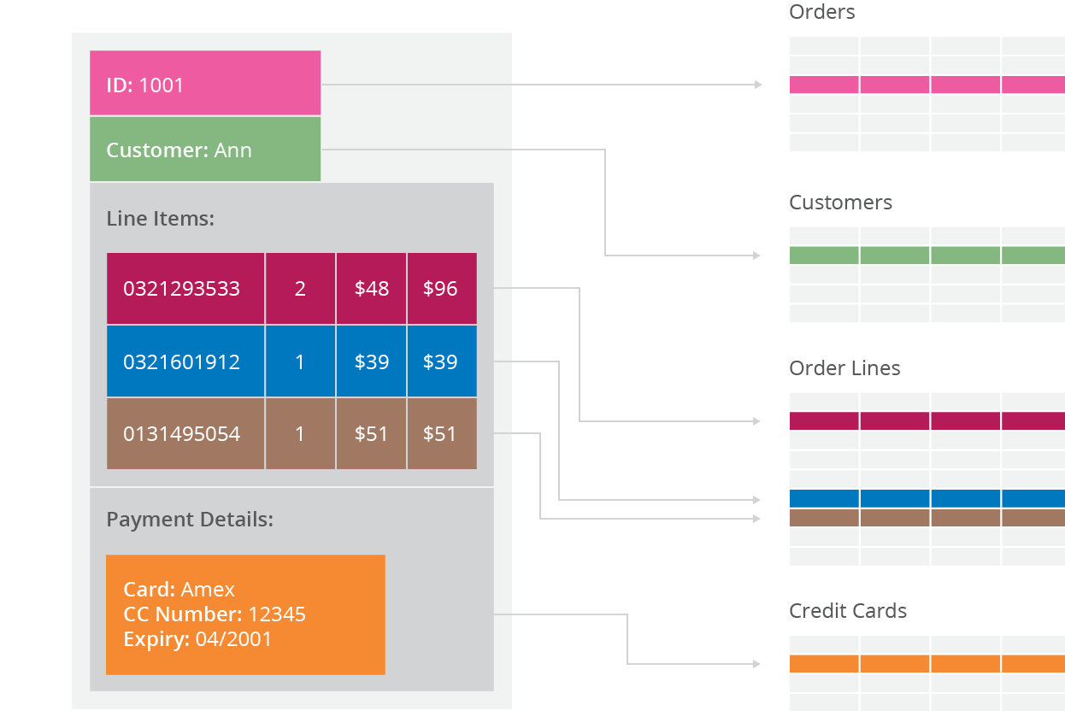
Why NoSQL? Impedance Mismatch

Slide 29
Why NoSQL? Impedance Mismatch
Application developers have been frustrated with the impedance mismatch between relational data structures and the in-memory data structures of the application
Using NoSQL databases allows developers to develop without having to convert in-memory structures to relational structures

Slide 30
Why NoSQL? Impedance Mismatch (In Depth)
Relational database modelling is vastly different than the types of data structures that application developers use
Using the data structures as modelled by the developers to solve different problem domains has given rise to movement away from relational modelling and towards aggregate models,
Most of this is driven by Domain Driven Design, a book by Eric Evans
An aggregate is a collection of data that we interact with as a unit.
These units of data or aggregates form the boundaries for ACID operations with the database
Key-value, Document, and Column-family databases can all be seen as forms of aggregate-oriented database

Slide 31
Why NoSQL? Impedance Mismatch (In Depth)
Aggregates make it easier for the database to manage data storage over clusters…
Since the unit of data now could reside on any machine and when retrieved from the database gets all the related data along with it
Aggregate-oriented databases work best when most data interaction is done with the same aggregate, for example when there is need to get an order and all its details
It better to store order as an aggregate object but dealing with these aggregates to get item details on all the orders is not elegant

Slide 32
Why NoSQL? Impedance Mismatch (In Depth)
Aggregate-oriented databases make relationships between aggregates more difficult to handle
Foreign keys relationships are often not supported
Also joins are not often supported
Aggregate-oriented databases often support computing (materialized) views to provide data organized differently from the primary aggregates
This is often done with some variant of MapReduce computations

Slide 33
Why NoSQL? Services Mismatch
There is also movement away from using databases as integration points…
In favor of encapsulating databases with applications and integrating using services (Web Services, Cloud, Docker)
The rise of the web as a platform also had a profound impact on data storage…
With the need to support much larger volumes of data by running on clusters
But typical relational databases were not designed to run efficiently on (large) clusters

Slide 34
Why NoSQL? Services Mismatch
Sales System
Sales System
Sales Database
Common database for integration
Web
Services
Inventory System
Inventory Database
Inventory System

Slide 35
NoSQL Summary
NoSQL databases reject:
Overhead of ACID transactions
“Complexity” of SQL
Burden of up-front schema design
Declarative query expression
Yesterday’s technology
Programmer responsible for
Step-by-step procedural language
Navigating access path

Slide 36
NoSQL Database Advantages
Linear scaling takes place as new processing nodes are added to the cluster
Lower operational costs are obtained by auto-sharding
There’s no need for an object-relational mapping layer
It’s easy to store high-variability data

Slide 37
NoSQL Database Drawbacks
ACID transactions can be done only within a row or document at the database level
Other transactions must be done at the application level
Document stores don’t provide fine-grained security at the element level
NoSQL systems are new to many staff members and additional training may be required
Has its own proprietary nonstandard query language, which prohibits portability
May not work with existing reporting and OLAP tools

Slide 38
SQL or NoSQL: Which is Right for You?
Need | NoSQL | SQL
Do you want a relational database? | No | Yes
Do your records have consistent properties? | No | Yes
Is your data highly variable in structure? | Yes | No
How would you like relationships captured? | Denormalized | Normalized
Do you want to easily join across data? | No | Yes
Is your data structured? | Sort of | Yes

Slide 39
SQL or NoSQL: Which is Right for You?
Need | NoSQL | SQL
How are your schemas? | Dynamic, flexible or none | Static and well defined
Do you require ACID transactions? | No | Yes
How important is consistency? | Varies according to solution | Strong support for consistency
How would you like to scale? | Mostly horizontally | Mostly vertically

Slide 40
NewSQL More OLTP Throughput, Real-time Analytics
SQL as the primary mechanism for application interaction
ACID support for transactions
A non-locking concurrency control mechanism so real-time reads will not conflict with writes, and thereby cause them to stall.
An architecture providing much higher per-node performance than available from traditional relational databases
A scale-out, shared-nothing architecture, capable of running on a large number of nodes without bottlenecking

Slide 41
Database Summary
SQL Databases
Predefined Schema
Standard definition and interface language
Tight consistency
Well defined semantics
NoSQL Database
No predefined Schema
Per-product definition and interface language
Getting an answer quickly is more important than getting a correct answer

Slide 42
High Level System Classification
To abstract from the implementation details of individual NoSQL systems, high-level classification criteria can be used to group similar data stores into categories
Here we introduce the two most prominent approaches: data models and CAP theorem classes

Slide 43
Data Models
The most common distinction between NoSQL databases is the way they store and allow access to data
Each NoSQL database can be categorized as aligning with one of four possible data models
Key-value store
Document store
Wide column store
Graph store

Slide 44
Data Models
Note that SQL databases may also store data from one or more of these categories…
But in doing so they diverge from the relational model in one way or another and depart from use of standard SQL
Also such databases do not offer the horizontal scalability and high availability characteristics of a NoSQL database

Slide 45
Key Value Store
A key-value store consists of a set of key-value pairs with unique keys
Due to this simple structure, it only supports get and put operations
As the nature of the stored value is transparent to the database…
Pure key-value stores do not support operations beyond simple Create, Read, Update, Delete (CRUD)
Key-value stores are therefore often referred to as schemaless…
Any assumptions about the structure of stored data are implicitly encoded in the application logic (schema-on-read)…
And not explicitly defined through a data definition language (schema-on-write).

Slide 46
Key Value Store
The obvious advantages of this data model lie in its simplicity
The very simple abstraction makes it easy to partition and query the data…
So that the database system can achieve low latency as well as high throughput
If an application demands more complex operations, e.g. range queries, this data model is not powerful enough
Since queries more complex than simple lookups are not supported…
Data has to be analyzed inefficiently in application code to extract information

Slide 47
Key Value Store

Slide 48
Wide Column Store
Wide column stores extend key value stores by imposing some structure on the value linked to each row key
This structure has four levels: column, column family, row, table
A column is something like a name value pair and a column family is a named group of columns

Slide 49
Wide Column Store
Column families
Row key
Personal data
Professional data
ID | First Name | Last Name | Date of Birth | Job Category | Salary | Date of Hire | Employer
Column qualifiers
Notes:
"Microarrays allow us to see if a particular gene is on or off in a particular tissue. The colors on this picture correspond to whether or not the gene is expressed. So each row is a gene, and each column is a particular experiment, for example a particular type of tissue. If you see a red spot for some gene for breast tumors, that means this gene is expressed in breast cancer. But that same gene is not expressed in the brain, for example."

Slide 50
Wide Column Store
Personal data
Professional data
ID | First Name | Last Name | Date of Birth | Job Category | Salary | Date of Hire | Employer
ID | First Name | Middle Name | Last Name | Job Category | Employer | Hourly Rate
ID | First Name | Last Name | Job Category | Salary | Employer | Group | Seniority | Bldg # | Office #
ID | Last Name | Job Category | Salary | Date of Hire | Employer | Insurance ID | Emergency Contact
Medical data
One “table”
Notes:
These are all in the same table.

Slide 51
Wide Column Store
Row key
t₁
t₀
ID | First Name | Last Name | Date of Birth | Job Category | Salary | Date of Hire | Employer
Personal data
Professional data
One “row”
One “row” in a wide-column NoSQL database table
=
Many rows in several relations/tables in a relational database
Notes:
Compared to the relational model, this is relatively primitive.
No notion of normalization or dependency.
No query model, per se.
Operations are very primitive, and put the burden on the software for sophisticated processing.

Slide 52
Wide Column Store
A sparse storage scheme makes tables with arbitrarily many columns feasible…
Because there is no column key without a corresponding value
Hence, null values can be stored without any space overhead
The set of all columns of a column family is collocated on disk for efficient access together
On disk, wide-column stores do not group all data from each row together…
But instead group values of the same column family and from the same row
So, a row cannot be retrieved by one single lookup as in a document store, but has to be joined together…
Each column facility acts somewhat like a separate table in a relational database

Slide 53
Wide Column Store
Examples: Cassandra (AP), Google BigTable (CP), HBase (CP)

Slide 54
Document Stores
A document store is a key-value store that restricts values
to semi-structured formats such as JSON documents
This restriction, in comparison to key-value stores, brings great flexibility in accessing the data
It is not only possible to fetch an entire document by its key, but also to retrieve only parts of a document…
And to also execute range queries or full-text searches
Unlike traditional relational databases, the schema for each document, even in the same collection, can vary
Documents are grouped into “collections,” which serve a similar purpose to a relational table
A document database provides a query mechanism to search collections for documents with particular attributes

Slide 55
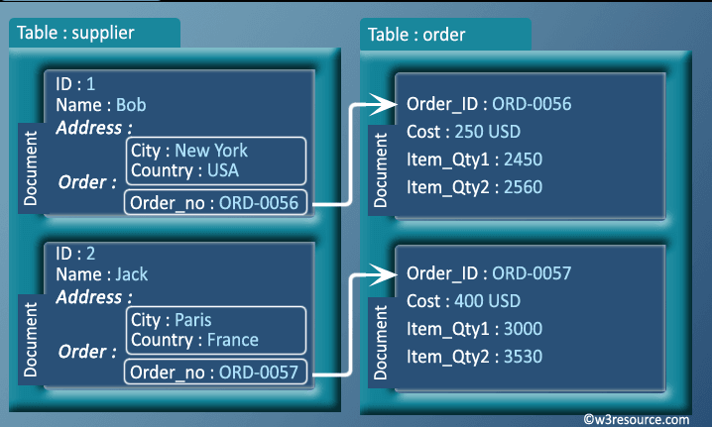
Document Stores

Slide 56
Graph Stores
Graph databases allow you to store entities and relationships between these entities
Entities are also known as nodes (vertices), which have properties
Think of a node as an instance of an object in the application
Relations are known as edges that can have properties
Nodes are organized by relationships which allow you to find interesting patterns between the nodes
The organization of the graph lets the data be stored once and then interpreted in different ways based on relationships.
In graph databases, traversing the joins or relationships is very fast
The relationship between nodes is not calculated at query time but is actually persisted as a relationship
Traversing persisted relationships is faster than calculating them for every query.

Slide 57
Graph Stores
Examples: Neo4j (CA), InfiniteGraph (CA), OrientDB (CA)

Slide 58
Consistency Versus Availability
Another defining property of a NoSQL (distributed) database, is the level of functionality that it provided during a network partition
Network Partition
The network stops delivering messages between subsets of servers
Clients may access servers in each partition but these servers cannot communicate with one another
So a write to servers in one partition cannot be shared with servers in other partitions

Slide 59
Consistency Versus Availability
Some databases are built to favor consistency under a network partition while others favor availability
This trade-off is inherent to every distributed database system
The huge number of different NoSQL systems shows that there is a wide spectrum between the two paradigms
In the following, we explain two theorems, CAP and PACELC…
According to which database systems can be categorized by their respective positions in this spectrum

Slide 60
CAP Theorem
Conjectured by Prof. Eric Brewer at PODC (Principle of Distributed Computing) 2000 keynote talk
Described the trade-offs involved in distributed systems around consistency and availability

Slide 61
CAP Theorem
Brewer argues that a system can be both available and consistent in normal operation, but in the presence of a system partition, this is not possible
If a system continues to work in spite of the partition…
There is some non-failing node that has lost contact to the other nodes so the system must decide among 2 options
To continue processing client requests to preserve availability (AP)
Or to reject client requests in order to uphold consistency guarantees (CP)
The first option violates consistency, because it might lead to stale reads and conflicting writes
While the second option obviously sacrifices availability

Slide 62
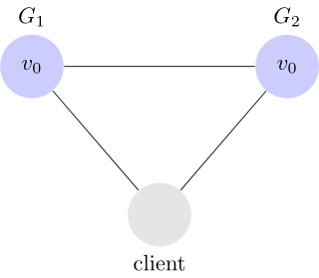
Distributed Database System Model
Let's consider a very simple distributed system
Our system is composed of two servers, G1 and G2
Both servers keep track of the same variable v, with an initial value v0
G1 and G2 can communicate with each other and can also communicate with external clients

Slide 63
Distributed Database System Consistency
Any read operation that begins after a write operation completes must return that value (or the result of a later write operation)
In a consistent system, once a client writes a value to any server and gets a response, it expects to get that value (or a fresher value) back from any server it reads from.

Slide 64
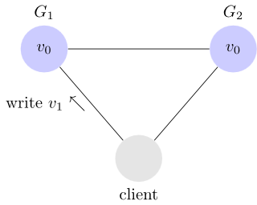
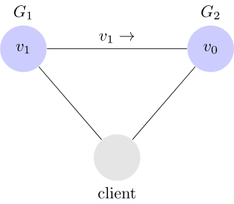
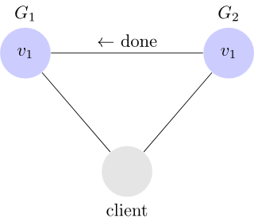
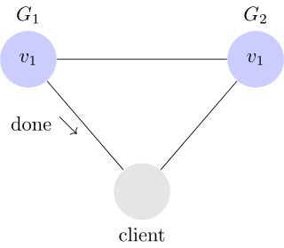
Distributed Database System Example of a Consistent System (Write Phase)
Step 1
Step 2
Step 3
Step 4

Slide 65
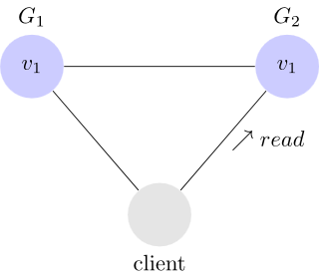
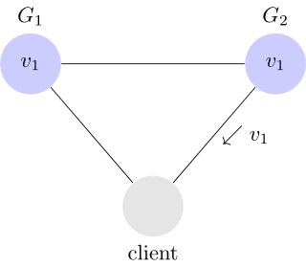
Distributed Database System Example of a Consistent System (Read Phase)
In this system, G1 replicates its value to G2 before sending an acknowledgement to the client
When the client reads from G2, it gets the most up to date value of v which is v1

Slide 66
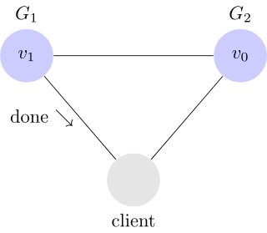
Distributed Database System Example of a Inconsistent System (Write Phase)

Slide 67
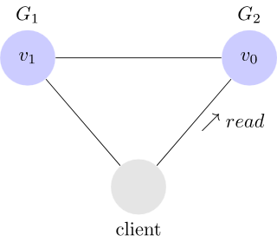
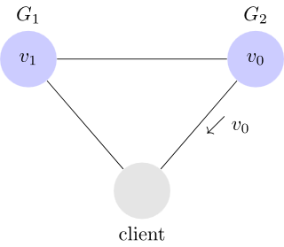
Distributed Database System Example of a Inconsistent System (Read Phase)
Our client writes v1 to G1 and G1 acknowledges, but when it reads from G2 , it gets stale data v0

Slide 68
Distributed Database System Availability
Every request received by a non-failing node in the system must result in a response
In an available system, if our client sends a request to a server and the server has not crashed, then the server must eventually respond to the client
The server is not allowed to ignore the client's requests

Slide 69
Distributed Database System Example of Availability
X
X
Even though G1 has failed, this does not impact the ability of G2 to service requests

Slide 70
Distributed Database System Partition Tolerance
The network will be allowed to lose arbitrarily many messages sent from one node to another
This means that any messages G1 and G2 send to one another can be dropped

Slide 71
Distributed Database System Example of Partition Tolerance
X
X
Even though the connection between G1 and G2 has failed, this does not impact the ability of G2 to service requests

Slide 72
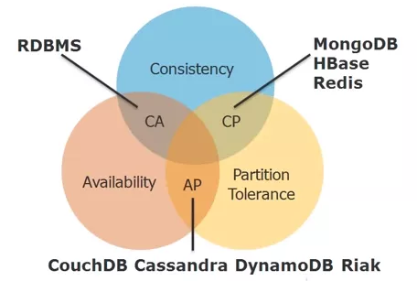
CAP Theorem
In the face of a network partition a distributed database must choose to be either available or consistent, but it cannot choose both

Slide 73
CAP Theorem
The CAP theorem demands you answer this question…
Do I give up strict consistency, or give up ensured availability?
Do we lock out requests until consistency can be enforced across all nodes?
Or do we service requests and accept that data on nodes may be (or become) inconsistent?
Strict
Consistency
Ensured Availability

Slide 74
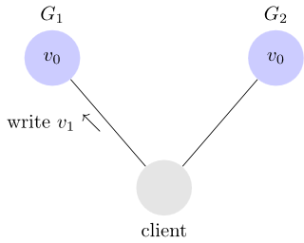

CAP Theorem AP: Available, Partition Tolerant, Not Consistent (Write Phase)
Since our system is available G1 must respond
Since the network is partitioned G1 cannot replicate its data to G2

Slide 75
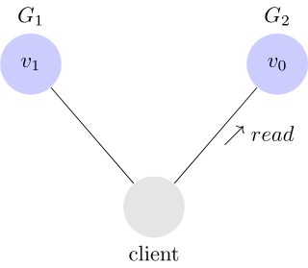

CAP Theorem AP: Available, Partition Tolerant, Not Consistent (Read Phase)
Since our system is available, G2 must respond
And since the network is partitioned, G2 cannot update its value from G1
So a client would obtain different values of V depending on whether it issues a read to G1 or G2

Slide 76

CAP Theorem CP: Consistent, Partition Tolerant, Not Available
Since the network is partitioned G1 cannot replicate its data to G2
To remain consistent the write must be delayed (or fail) until G1 and G2 can communicate

Slide 77
CAP Theorem CA: Consistent, Available, Not Partition Tolerant
There are also systems that usually are available and consistent, but fail completely when there is a partition (CA)
For example, high performance vertically scalable single node relational systems…
Or systems which partition data across nodes but without replication

Slide 78
Why this is important?
The future of databases is distributed
The CAP theorem describes some of the tradeoffs involved in distributed systems
A proper understanding of the CAP theorem is essential to making decisions about the future of distributed database design
Misunderstanding can lead to erroneous or inappropriate design choices

Slide 79
Problem for Relational Database to Scale
The Relational Database is built on the principle of ACID (Atomicity, Consistency, Isolation, Durability)
It implies that a truly distributed relational database should have availability, consistency and partition tolerance.
Which unfortunately is impossible …

Slide 80
Types of Consistency
Strong Consistency
After the update completes, any subsequent access will return the same updated value.
Weak Consistency
It is not guaranteed that subsequent accesses will return the updated value.
Eventual Consistency
Specific form of weak consistency
It is guaranteed that if no new updates are made to object, eventually all accesses will return the last updated value (e.g., propagate updates to replicas in a lazy fashion)

Slide 81



Eventual Consistency - A Facebook Example
Bob finds an interesting story and shares with Alice by posting on her Facebook wall
Bob asks Alice to check it out
Alice logs in her account, checks her Facebook wall but finds:
- Nothing is there!
?

Slide 82

Eventual Consistency - A Facebook Example
Bob tells Alice to wait a bit and check out later
Alice waits for a minute or so and checks back:
- She finds the story Bob shared with her!

Slide 83
Eventual Consistency - A Facebook Example
Reason: it is possible because Facebook uses an eventual consistent model
Why Facebook chooses eventual consistent model over the strong consistent one?
Facebook has more than 1 billion active users
It is non-trivial to efficiently and reliably store the huge amount of data generated at any given time
Eventual consistent model offers the option to reduce the load and improve availability

Slide 84
Tunable Availability and Consistency
In practice most distributed databases allow tradeoffs between consistency and availability
As an example we will consider Riak key-value NoSQL database
Riak’s solution is based on Amazon Dynamo's novel approach of a tunable AP system
Riak is highly available to serve requests, with the ability to tune its level of consistency
Uses the concept of voting quorum of servers similar to the approach used by Zookeeper

Slide 85
Quorums
Peer-to-peer replication with replication factor N
Number of replicas of each data object
Write quorum: W
When writing, at least W replicas have to agree
Having W > N/2 results in write consistency
in case of two simultaneous writes, only one can get the majority
Read quorum: R
Number of peers contacted for a single read
For a strong read consistency: R + W > N
reader surely does not read stale data

Slide 86

Quorums: Example
Replication factor N = 3
Write quorum: W = 2 (W > N/2)
Write operation waits until 2 nodes acknowledge the write
Read quorum: R = 2 (R + W > N)
Two nodes contacted for read and thus surely the newest data is returned
Write(key, A)
Write(key, B)
peer 1
peer 2
Read(key)
peer 3

Slide 87
Tunable Availability and Consistency
Riak provides three tuning variables r, w, n where…
r=number of nodes that should respond to a read request before its considered successful
w=number of nodes that should respond to a write request before its considered successful
n=number of nodes where the data is replicated aka replication factor

Slide 88
Tunable Availability and Consistency
We can tweak the r, w, n values to make the system very consistent by setting r=5 and w=5
Each write and read operation was successful for each node
Now we have made the cluster susceptible to network partitions…
Since any write will not be considered successful when any node is not responding
We can make the same cluster highly available for writes or reads by setting r=1 and w=1
Each write or read must be successful on a single node
But now consistency can be compromised since some nodes may not have the latest copy of the data

Slide 89
Dynamic Tradeoff between C and A
An airline reservation system:
When most of seats are available: it is ok to rely on somewhat out-of-date data, availability is more critical
When the plane is close to be filled: it needs more accurate data to ensure the plane is not overbooked, consistency is more critical

Slide 90
Heterogeneity: Segmenting C and A
No single uniform requirement
Some aspects require strong consistency
Others require high availability
Segment the system into different components
Each provides different types of guarantees
Overall guarantees neither consistency nor availability
Each part of the service gets exactly what it needs
Can be partitioned along different dimensions

Slide 91
What if there are no partitions?
Tradeoff between Consistency and Latency:
Caused by the possibility of failure in distributed systems
High availability -> replicate data -> consistency problem
Basic idea:
Availability and latency are arguably the same thing: unavailable -> extreme high latency
Achieving different levels of consistency/availability takes different amount of time

Slide 92
Durability
The CAP theorem states that if you get a network partition…
You have to trade off the availability of data versus the consistency of data
But the CAP theorem does not speak to other failures such as the lose of a compute node or disk drive
Durability is that property of a system which operates to preserve its data in the face of such hardware failures
In this case the tradeoff for distributed database systems is between durability and latency

Slide 93
Durability
Durability is provided through data replication as we have seen with HDFS which replicates each file block 3 times by default
But when we write a new value to the database we might need to wait until that value is replicated across those 3 nodes
If a write request must wait until a new value is replicated across multiple node then we trade off higher latency for durability
But now assume replication can occur asynchronously to the completion of the write…
We can decrease latency by allowing the write to complete before data is replicated across fewer than 3 nodes
However durability may be compromised in this case if not all replicas can be created (perhaps due to a network partition)

Slide 94
CAP Theorem Limitations
So the CAP theorem fails to capture the tradeoffs between availability and consistency during normal operations…
Even though this has proven to be much more influential on the design of distributed databases than the availability consistency tradeoff in failure scenarios

Slide 95
Latency Consistency Tradeoff
But durability through replication leads to another related tradeoff between latency and consistency
Between the time a replication is initiated and it completes some replicates may be out of date with others
So some readers may be provided with stale data while others might be provided with current data
It depends from which node the reader is provided data
But the CAP theorem fails to capture tradeoffs between latency and consistency during normal operations…
But this latency consistency tradeoff, in normal operation, has proven to be more influential on the design of NoSQL databases

Slide 96
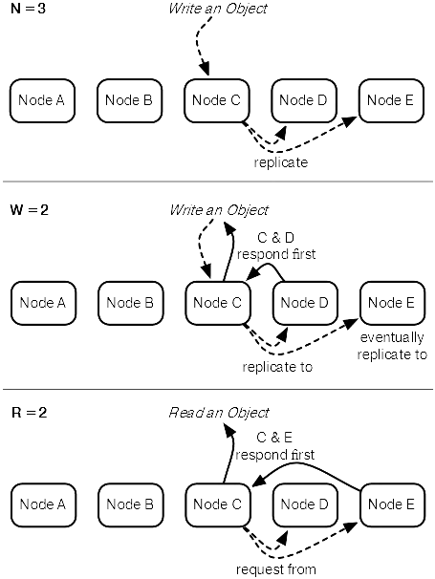
Latency Consistency Tradeoff
Replicate a new value to a total of three separate nodes

Slide 97
Latency Consistency Tradeoff
Replicate a new value to a total of three separate nodes
But complete a write when data is replicated only two times

Slide 98
Latency Consistency Tradeoff
Replicate a new value to a total of three separate nodes
Complete a read when a (consistent) value has been read from
only two nodes

Slide 99
PACELC
The PACELC theorem unifies both latency-consistency and availability-consistency tradeoffs
And so portrays the design space of distributed systems more accurately
From PACELC, we learn
In case of a Partition, there is an Availability-Consistency trade-off
Else, in normal operation, there is a Latency-Consistency trade-off
This classification offers two possible choices for the partition scenario (A/C)
And also two possible choices for normal operation (L/C)
Thus PACELC appears more fine-grained than the CAP classification

Slide 100
PACELC
C
A
C
L
Normal
Partitioned

Slide 101
Replication Strategies
Replication allows the system to maintain some level of availability and durability in the face of system errors
But storing the same records on different nodes in the cluster introduces the problem of data synchronization
And so a tradeoff between consistency on the one hand and latency and availability on the other
Gray propose a classification of different replication strategies according to when updates are propagated to replicas and where updates are accepted

Slide 102
Replication Strategies
There are two possible choices of “when”
Eager (synchronous) replication propagates incoming changes synchronously to all replicas before a commit can be returned to the client
Lazy (asynchronous) replication applies changes only at the receiving replica and passes them on asynchronously
The great advantage of eager replication is consistency among replicas…
But it comes at the cost of higher write latency due to the need to wait for other replicas
Lazy replication is faster, because it allows replicas to diverge; as a consequence, stale data might be served

Slide 103
Data Duplication Models: Overview
Scaling out = distributing the database on a cluster of servers
Two orthogonal techniques to data duplication:
Replication – the same data is copied over multiple nodes
Master-slave or peer-to-peer
Sharding – different data chunks are put on different nodes (data partitioning)
We can use either or combine them

Slide 104
Data Duplication Models Single Server
Running the database on a single machine is always the prefered scenario
it spares us a lot of problems
It can make sense to use NoSQL databases with a single-server distribution model
Other advantages remain: Flexible data model, simplicity
Graph databases: The graph is “almost” complete → it is difficult to distribute it

Slide 105
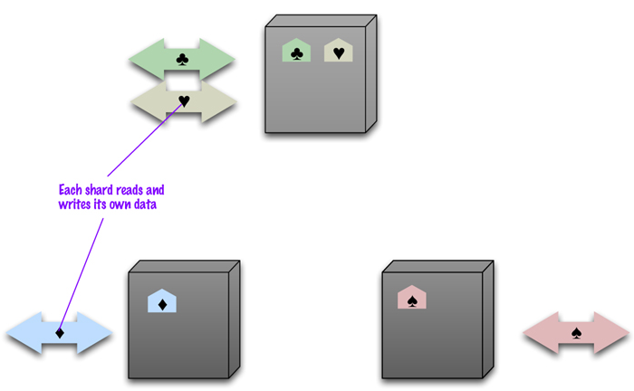
Data Duplication Models Sharding
Placing different parts of the data onto different servers
Different people are accessing different parts of the dataset
source: Sadalage & Fowler: NoSQL Distilled, 2012

Slide 106
Data Duplication Models Sharding (2)
We should try to ensure that
Data accessed together is kept together
So that user gets all data from a single server
Aggregates data model helps to achieve this
Arrange the data on the nodes:
Based on a physical location (of the data centers)
Keep the load balanced (can change in time)
Many NoSQL databases offer auto-sharding
A node failure makes shard’s data unavailable
Sharding is often combined with replication

Slide 107
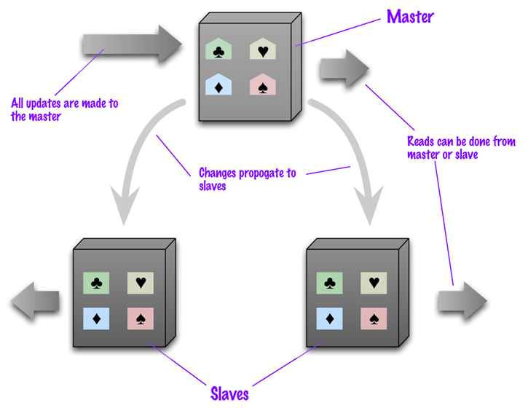
Data Duplication Models Master-slave Replication
We replicate data across multiple nodes
One node is designated as primary (master), others as secondary (slaves)
Master is responsible for processing all updates to the data
Reads from any node

Slide 108
Data Duplication Models Master-slave Replication (2)
For scaling a read-intensive application
More read requests → more slave nodes
The master fails → the slaves can still handle read requests
A slave can become a new master quickly (it is a replica)
Limited by ability of the master to process updates
Masters are selected manually or automatically
User-defined vs. cluster-elected

Slide 109
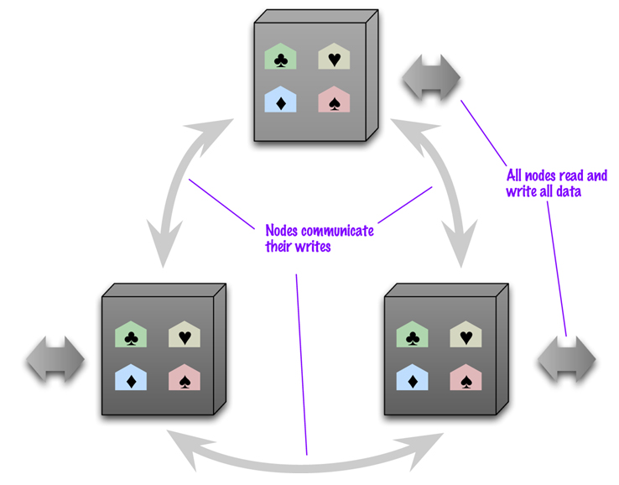
Data Duplication Models Peer-to-peer Replication
No master, all the replicas are equal
Every node can handle write and then spreads the update to the others
source: Sadalage & Fowler: NoSQL Distilled, 2012

Slide 110
Data Duplication Models Peer-to-peer Replication (2)
Problem: consistency
Users can write simultaneously at two different nodes
Solution:
When writing, the replicas coordinate to avoid conflict
At the cost of network traffic
The write operation waits till the process is finished
Not all replicas need to agree on the write, just a majority (details below)

Slide 111
Other NoSQL Database Attributes
Sharding
Replication
Storage Management
Query Processing
Range Sharding
Hash Sharding
Entity Group Sharding
Consistent Hash
Shared Disk
Consensus Protocol
Synchronous
Asynchronous
Primary Copy
Update Anywhere
Logging
Updates in Place
Caching
In Memory Storage
Append Only Storage
Global Secondary Indexing
Local Secondary Indexing
Query Planning
Materialized Views

Slide 112
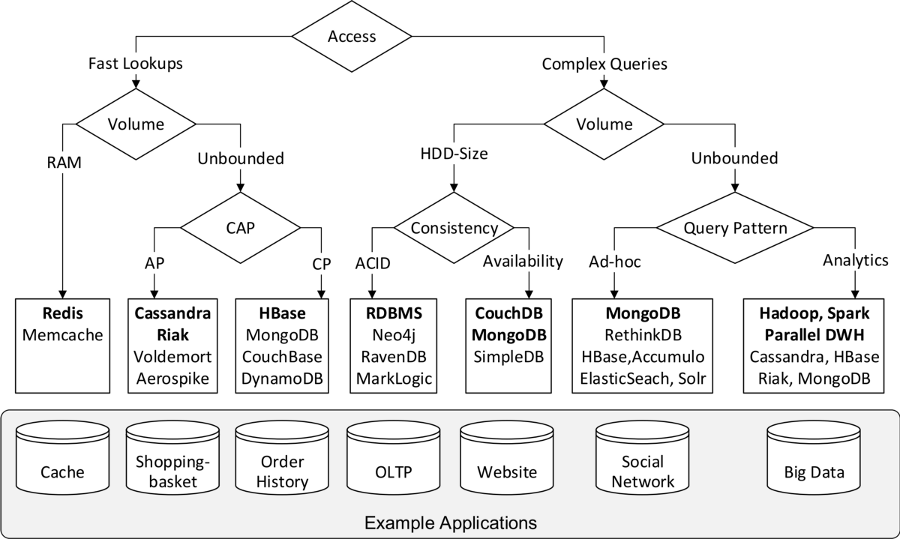
What Database Should I Choose?

